Slide 1
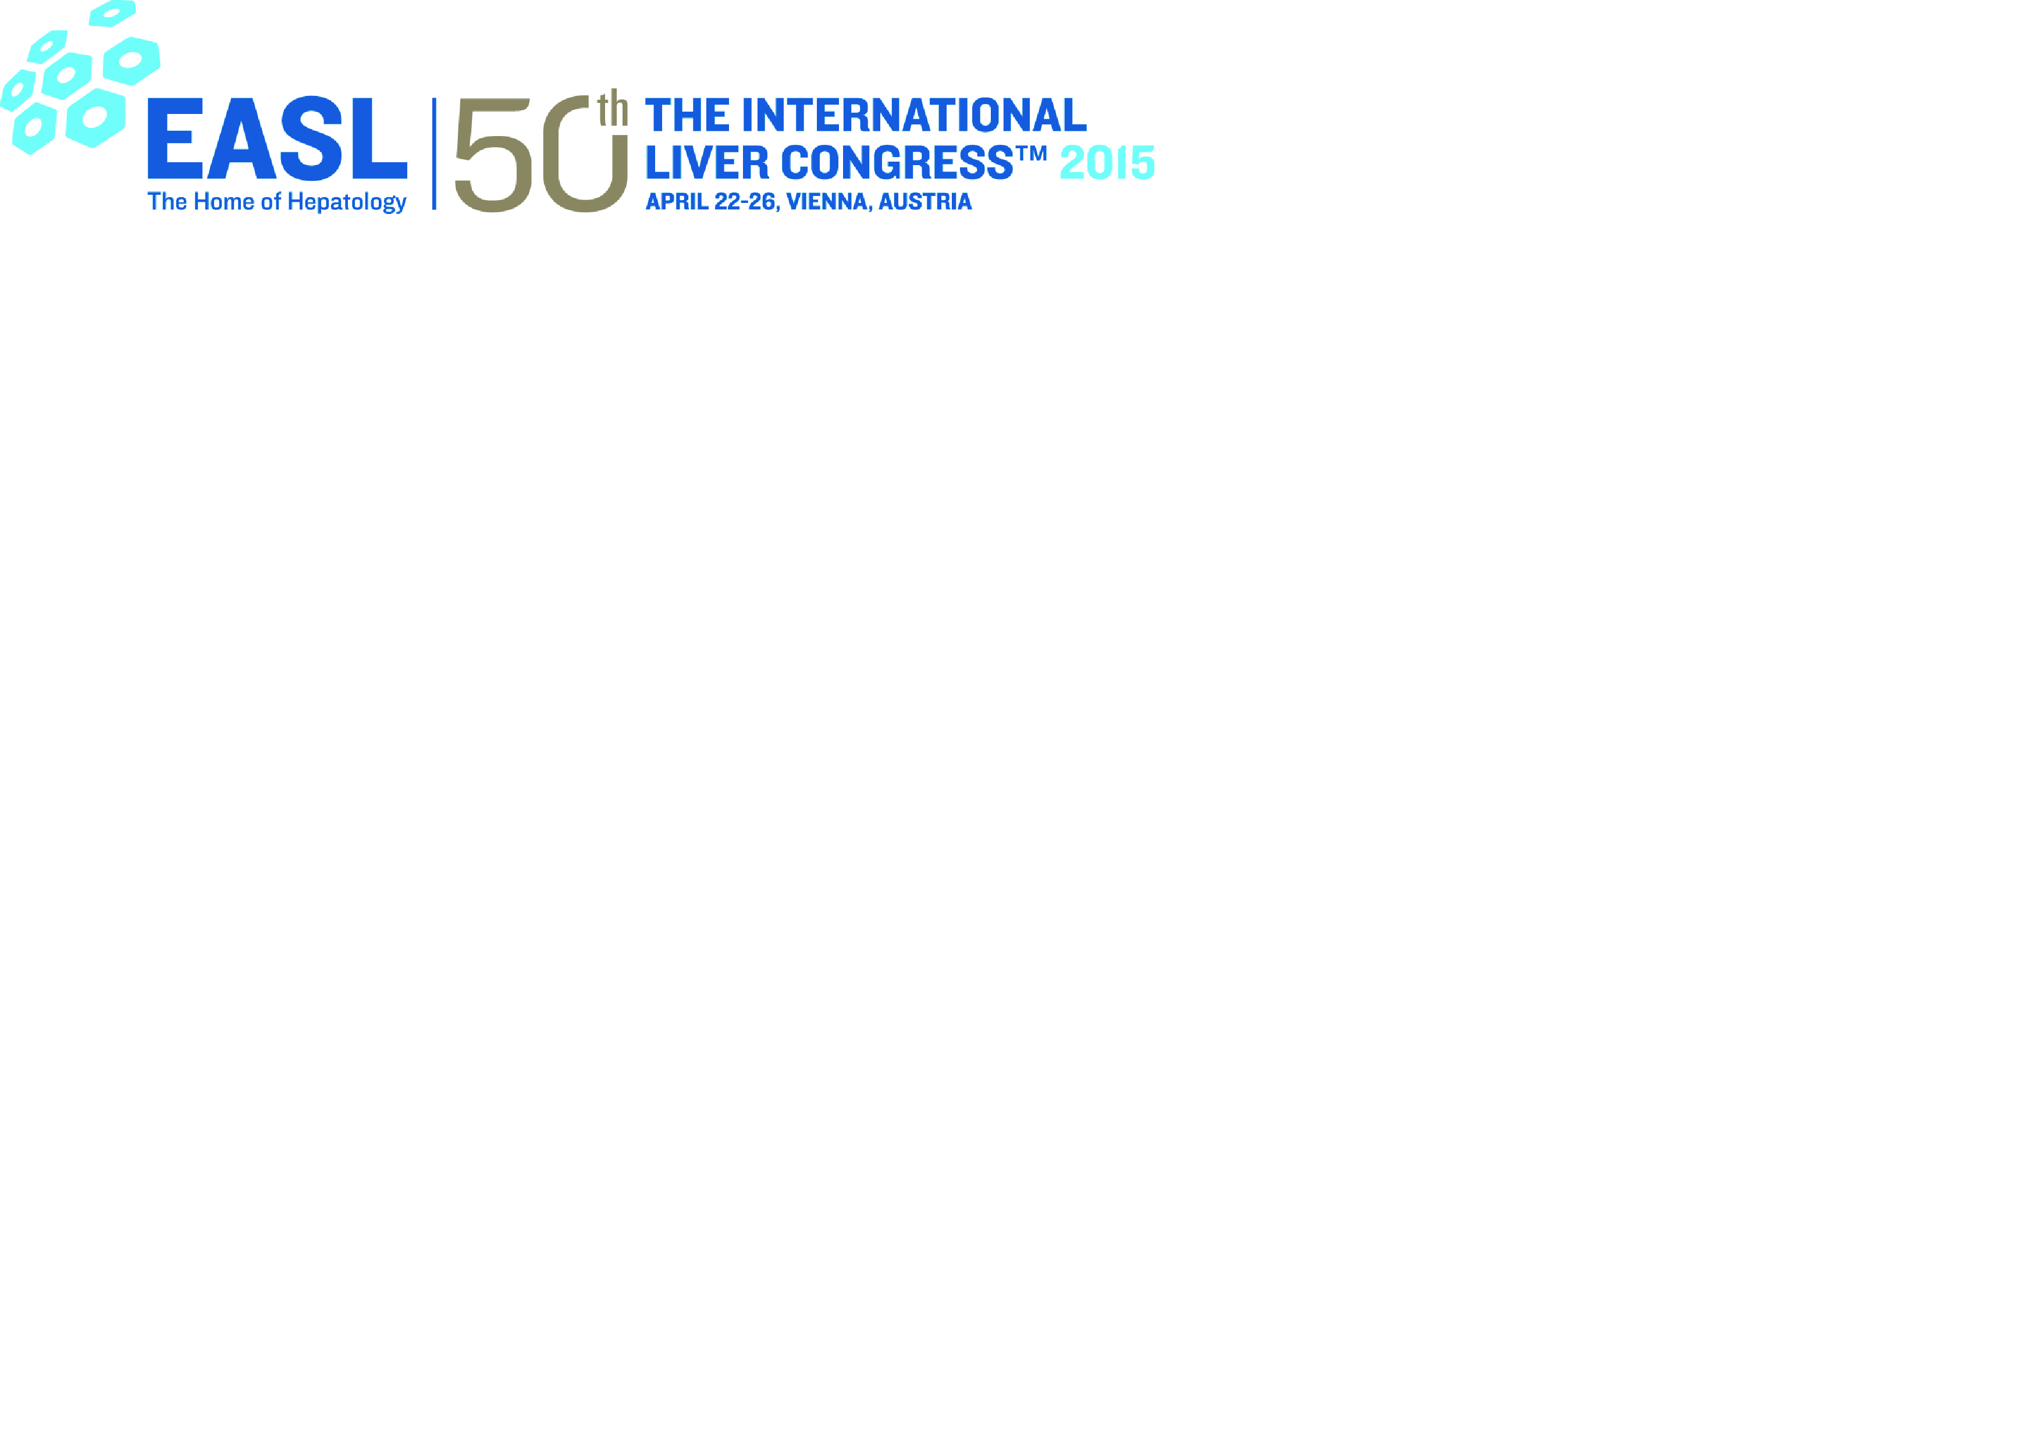
Risk stratification in PBC
Christophe Corpechot
Reference Center for Inflammatory Biliary Diseases
Saint-Antoine hospital, Paris , France

Slide 2
What is currently known (background)
PBC : chronic, progressive cholestatic disease
Significant risk of cirrhosis, liver failure, and death
Only one drug approved : UDCA (13-15 mg/kg/d)
Variable response from patient to patient
Still persistent risk of death or liver transplantation

Slide 3
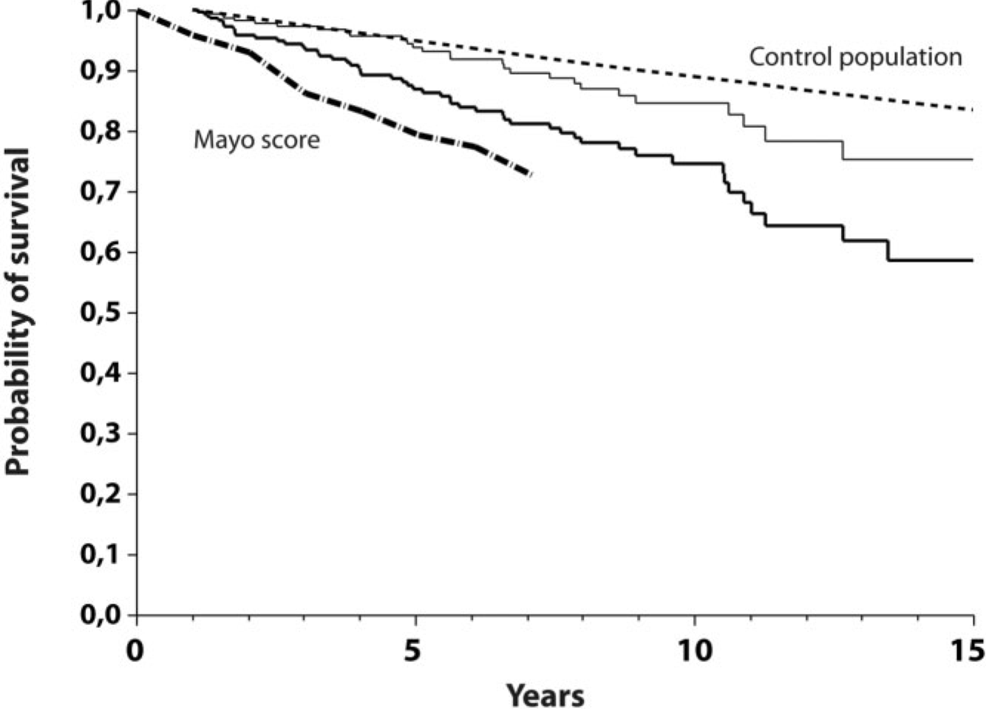
Long-term prognosis under UDCA
General population
Predicted survival
(Mayo risk score)
Overall survival
Transplant-free survival
(Corpechot et al. Hepatology 2008)

Slide 4
Main issues of clinical trials
Small-sized targeted population
  International multicenter recruitment
Slow disease progression
  Use of surrogate markers
Variable disease prognosis
  Patient selection and risk stratification

Slide 5
Selection/stratification & endpoints
Selection/stratification
Endpoints
Demographics & symptoms
Blood tests
Imaging techniques
Histology
Death or LT
Liver-related complications
Histological progression
Fibrosis markers
Biochemical response

Slide 6
Demographics & symptoms
Age
Gender
Symptoms

Slide 7
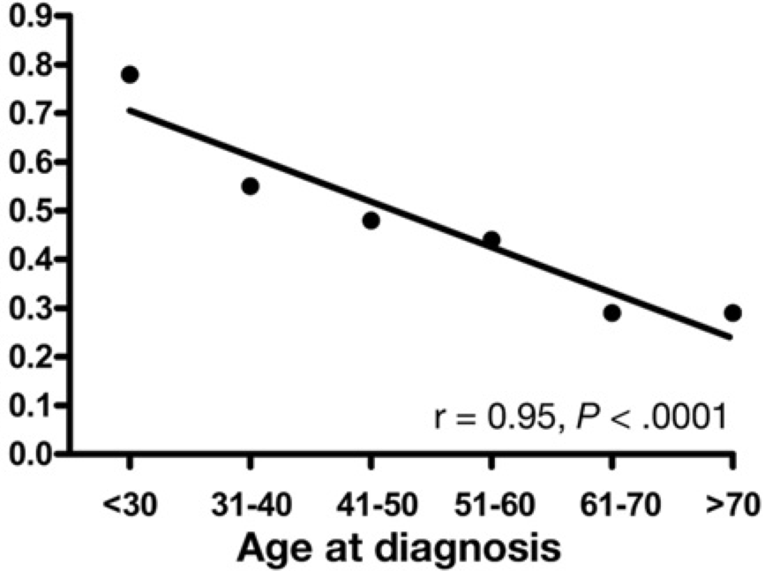
Demographics & symptoms
Age
Gender
Symptoms
The younger, the poorer response to UDCA
(Carbone et al. Gastroenterology 2013)
…and the higher mortality ratio
(Kubota et al. J Gastroenterol 2009)
Non responders
SMR | Young (< 55 yr) | Old (≥ 55 yr)
Overall deaths | 7.4 (3.0 - 15.2) | 1.1 (0.6 - 1.7)
Liver-related deaths | 218 (71- 509) | 23 (7.3 - 53)

Slide 8
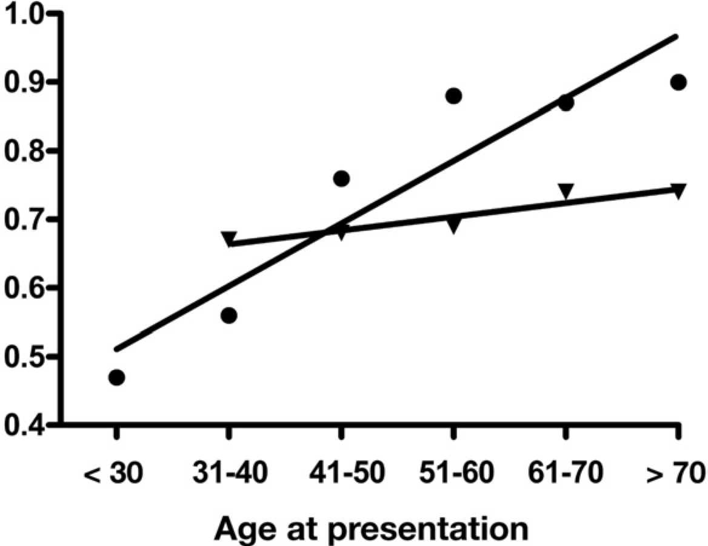
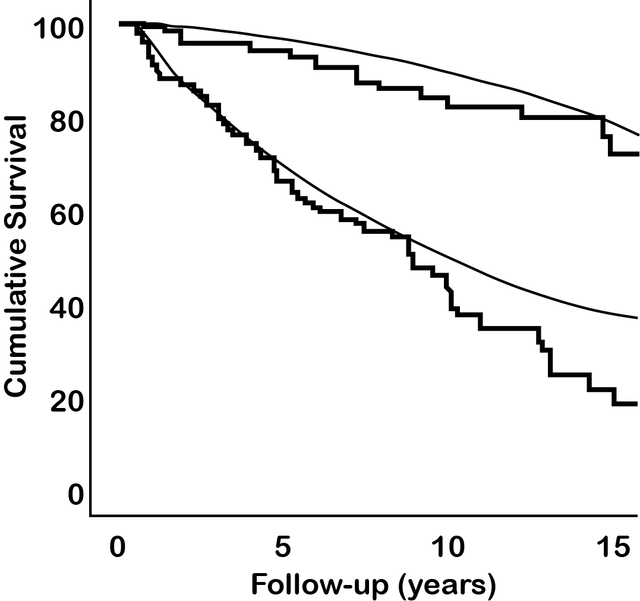
Demographics & symptoms
Age
Gender
Symptoms
Are men less responsive to UDCA?
(Carbone et al. Gastroenterology 2013)
Probably not...
(Cheung et al. EASL meeting 2015, abstract P1184)
Female sex
Responders
Male sex
Females, early stage
Males, early stage
Females, late stage
Males, late stage

Slide 9
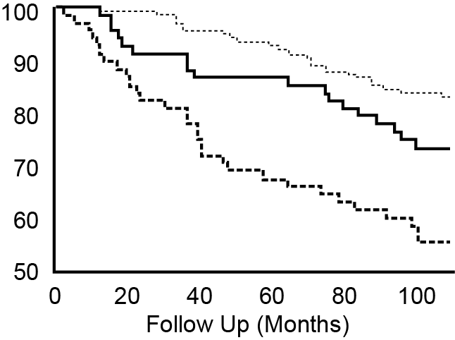
Demographics & symptoms
Age
Gender
Symptoms
Pruritus or fatigue are predictive of poor response and outcomes
(Quarneti et al. Liver Int 2015)
Fatigue by itself may be of prognostic significance
(Jones et al. J Hepatol 2010)
 | With | Without | P
Response (Paris I) | 47 (63%) | 114 (81%) | 0.005
Adverse outcomes | 23 (31%) | 19 (13%) | 0.004
LT-free survival
Control cohort
Non-fatigued PBC
Fatigued PBC

Slide 10
Blood tests
Baseline parameters
  Bilirubin & Albumin
  ELF test
  AST/platelet ratio
  PBC-specific ANA
Response to UDCA
  Definitions
  Paris criteria
  Optimized criteria
  New scores

Slide 11
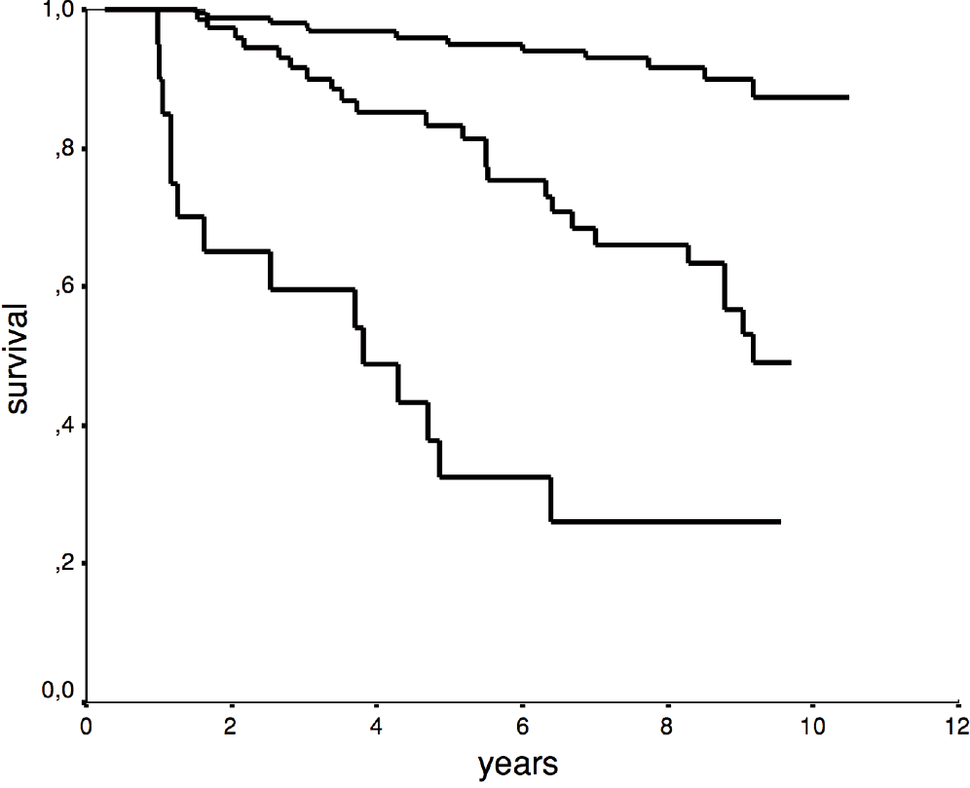
Blood tests
Baseline parameters
  Bilirubin & Albumin
  ELF test
  AST/platelet ratio
  PBC-specific ANA
Response to UDCA
  Definitions
  Paris criteria
  Optimized criteria
  New scores
Simple, efficient risk stratifiers at baseline
(ter Borg et al. Am J Gastroenterol 2006)
Normal bilirubin and albumin
Abnormal bilirubin or albumin
Abnormal bilirubin and albumin

Slide 12
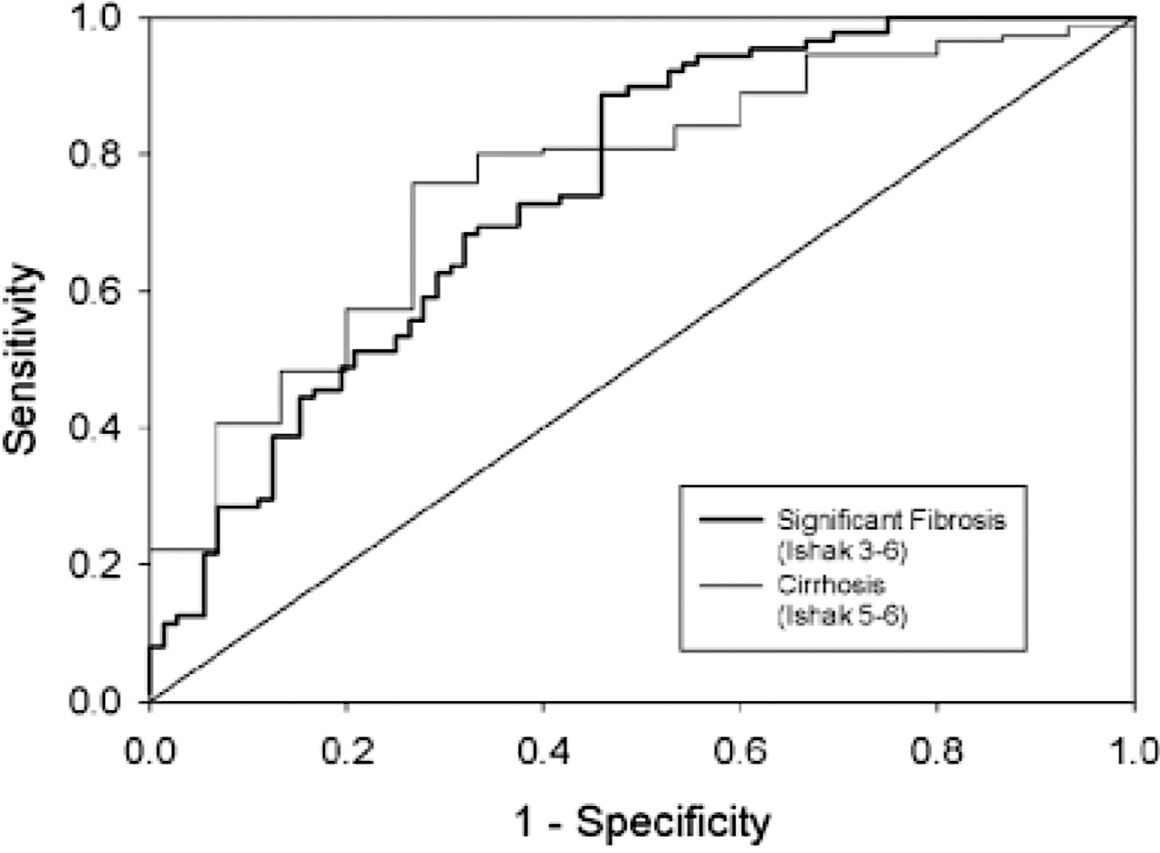
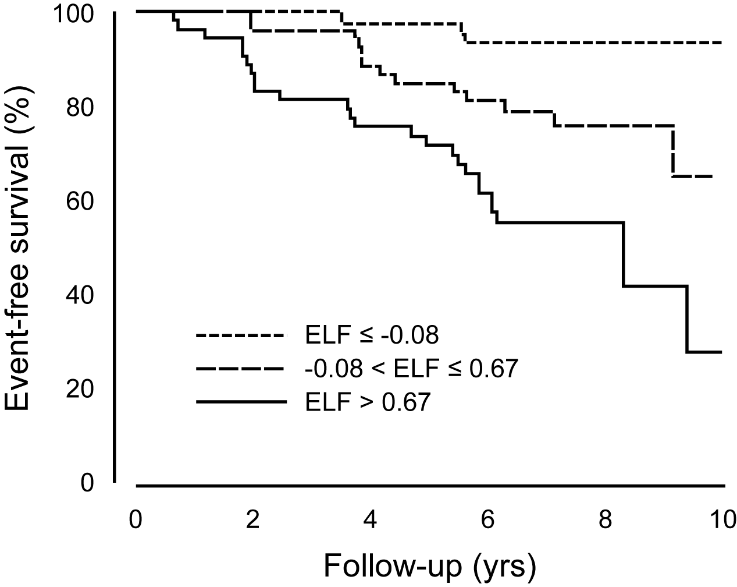
Blood tests
Baseline parameters
  Bilirubin & Albumin
  ELF test
  AST/platelet ratio
  PBC-specific ANA
Response to UDCA
  Definitions
  Paris criteria
  Optimized criteria
  New scores
Enhanced Liver Fibrosis (ELF) test
competes with histological stage in predicting outcomes
(Mayo et al. Hepatology 2008)

Slide 13
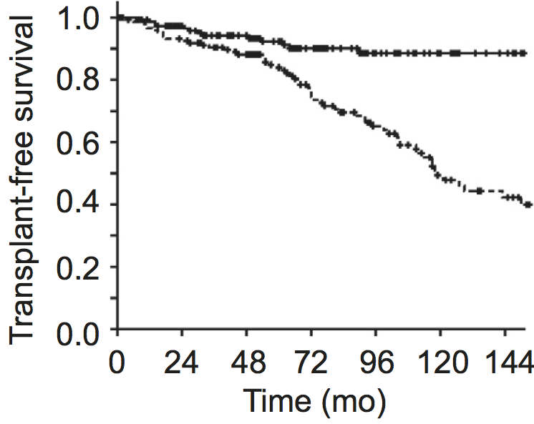
Blood tests
Baseline parameters
  Bilirubin & Albumin
  ELF test
  AST/platelet ratio
  PBC-specific ANA
Response to UDCA
  Definitions
  Paris criteria
  Optimized criteria
  New scores
Baseline APRI is predictive of death or liver transplantation
(Trivedi et al. J Hepatol 2014)
APRI ≤ 0.54
APRI > 0.54

Slide 14
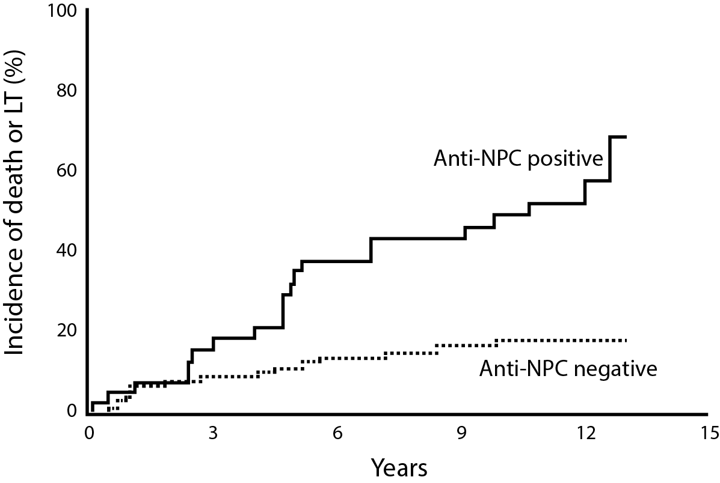
Blood tests
Baseline parameters
  Bilirubin & Albumin
  ELF test
  AST/platelet ratio
  PBC-specific ANA
Response to UDCA
  Definitions
  Paris criteria
  Optimized criteria
  New scores
Anti-nuclear pore complex (NPC) antibodies may identify high-risk patients for death or LT
(Wesierska-Gadek et al. Hepatology 2006)

Slide 15
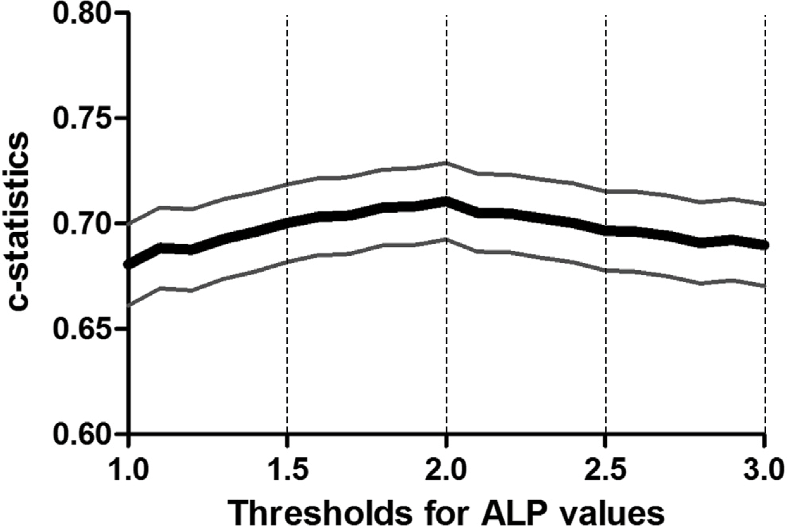
Blood tests
Baseline parameters
  Bilirubin & Albumin
  ELF test
  AST/platelet ratio
  PBC-specific ANA
Response to UDCA
  Definitions
  Paris criteria
  Optimized criteria
  New scores
Biochemical response to UDCA is a major predictor of death or LT
Which optimal ALP cutoff ?
(Lammers et al. Gastroenterology 2014)
Definition | Parameters | Time point
Barcelona | ∆(ALP) ≥ 40% ou ALP ≤ N | 12 mo.
Paris-I | ALP ≤ 3N, AST ≤ 2N, BILI ≤ N | 12 mo.
Toronto | ALP ≤ 1.67N | 24 mo.
Rotterdam | BILI ≤ N, ALB ≤ N | 12 mo.
Paris-II | ALP≤ 1.5N, AST≤ 1.5N, BILI ≤ N | 12 mo.
Global PBC | ALP ≤ 2N, BILI ≤ N | 12 mo.
P = NS
xULN

Slide 16
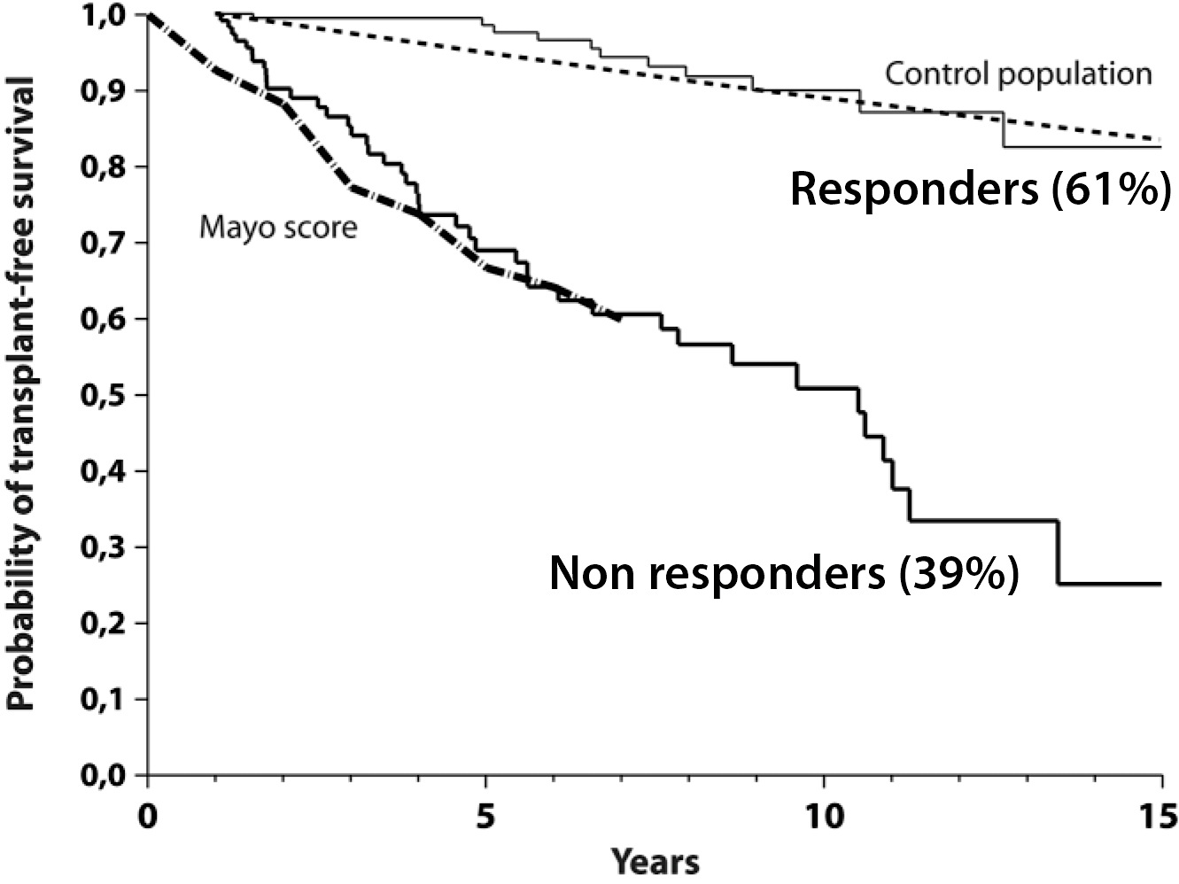
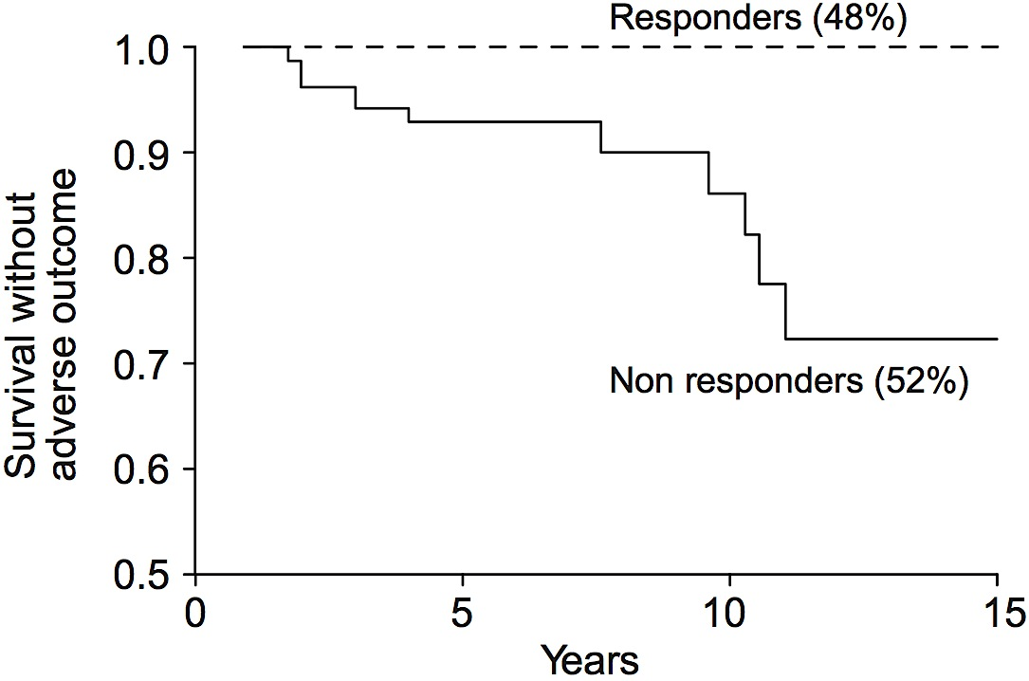
Blood tests
Baseline parameters
  Bilirubin & Albumin
  ELF test
  AST/platelet ratio
  PBC-specific ANA
Response to UDCA
  Definitions
  Paris criteria
  Optimized criteria
  New scores
ALP + AST + Bilirubin at 12 months
(Corpechot et al. Hepatology 2008; J Hepatol 2011)
Extensive validation (>1,000 pts)
(Carbone et al. Gastroenterology 2013)
All stages (Paris I)
Early stages (Paris II)
3 + 2 + 1 (ULN)
1.5 + 1.5 + 1 (ULN)
Criteria | Logrank | P-value
Paris I | 106 | < 1E-16
Paris II | 46 | 1.4E-11
Toronto | 24 | 8.8E-7
Barcelona | 7 | 6.7E-3

Slide 17
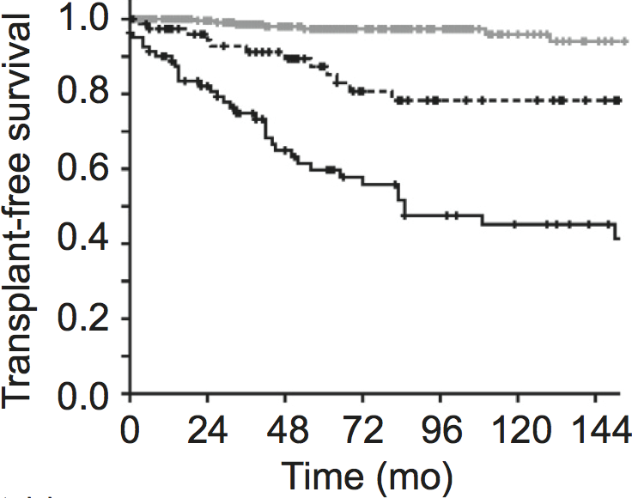
Blood tests
Baseline parameters
  Bilirubin & Albumin
  ELF test
  AST/platelet ratio
  PBC-specific ANA
Response to UDCA
  Definitions
  Paris criteria
  Optimized criteria
  New scores
APRI at 1 year improves Paris I criteria prediction
(Trivedi et al. J Hepatol 2014)
Paris-I responders
+ APRI-r ≤ 0.54
Paris-I responders
+ APRI-r > 0.54 or
Paris I non responders
+ APRI-r ≤ 0.54
Paris-I non responders
+ APRI-r > 0.54

Slide 18
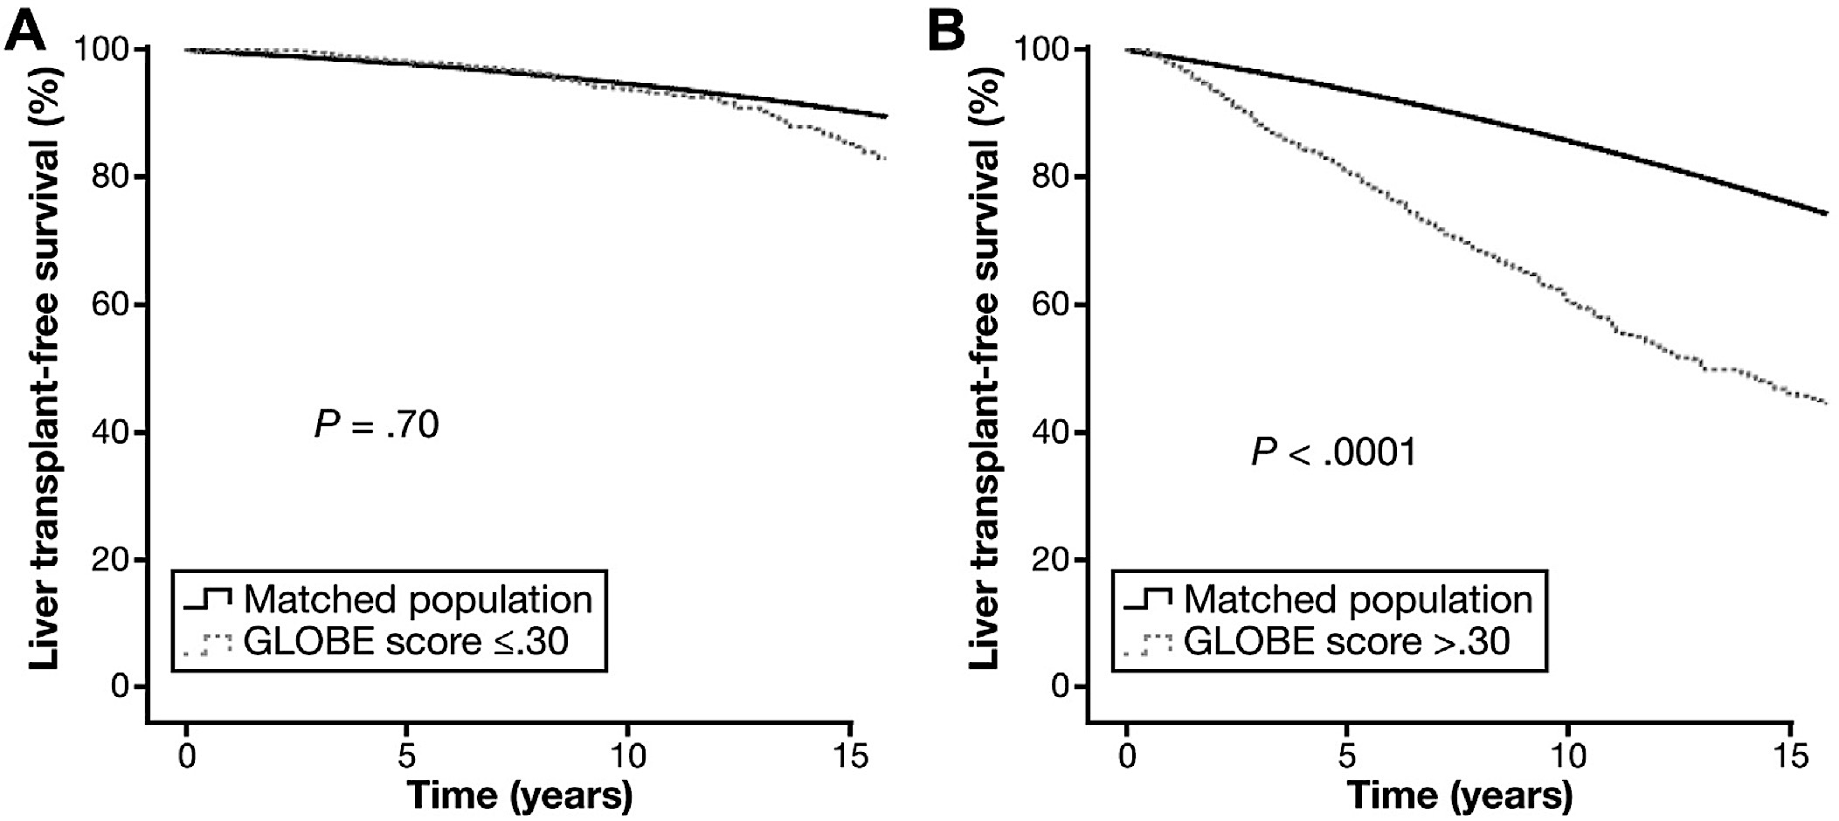
Blood tests
Baseline parameters
  Bilirubin & Albumin
  ELF test
  AST/platelet ratio
  PBC-specific ANA
Response to UDCA
  Definitions
  Paris criteria
  Optimized criteria
  New scores
Globe score
(Lammers et al. Gastroenterology 2015)
  Age at baseline, Bilirubin, ALP, Albumin at 12 mo.
  Predictive performance: 0.81
UK-PBC score
(Carbone et al. Hepatology 2015)
  Albumin and platelets at baseline, Bilirubin, ALP and Transaminase at 12 mo.
  Predictive performance: 0.95

Slide 19
Transient elastography
Evaluating severity
Predicting outcome
Limitations

Slide 20
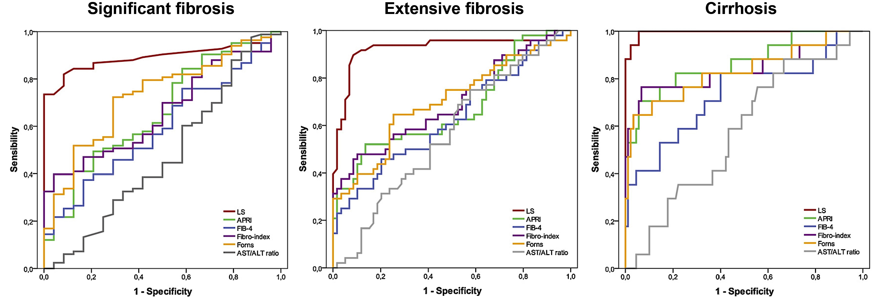
Transient elastography
Evaluating severity
Predicting outcome
Limitations
Liver stiffness vs. fibrosis stage
The best fibrosis marker of PBC?
(Floreani et al. Dig Liver Dis 2011; Corpechot et al.
Hepatology 2012)
 | Patients | Extensive fibrosis* | Cirrhosis*
Gomez et al. | 80 | 0.86 | 0.96
Floreani et al. | 120 | 0.92 | 0.99
Corpechot et al. | 146 | 0.95 | 0.99
*AUC for the specified stage

Slide 21
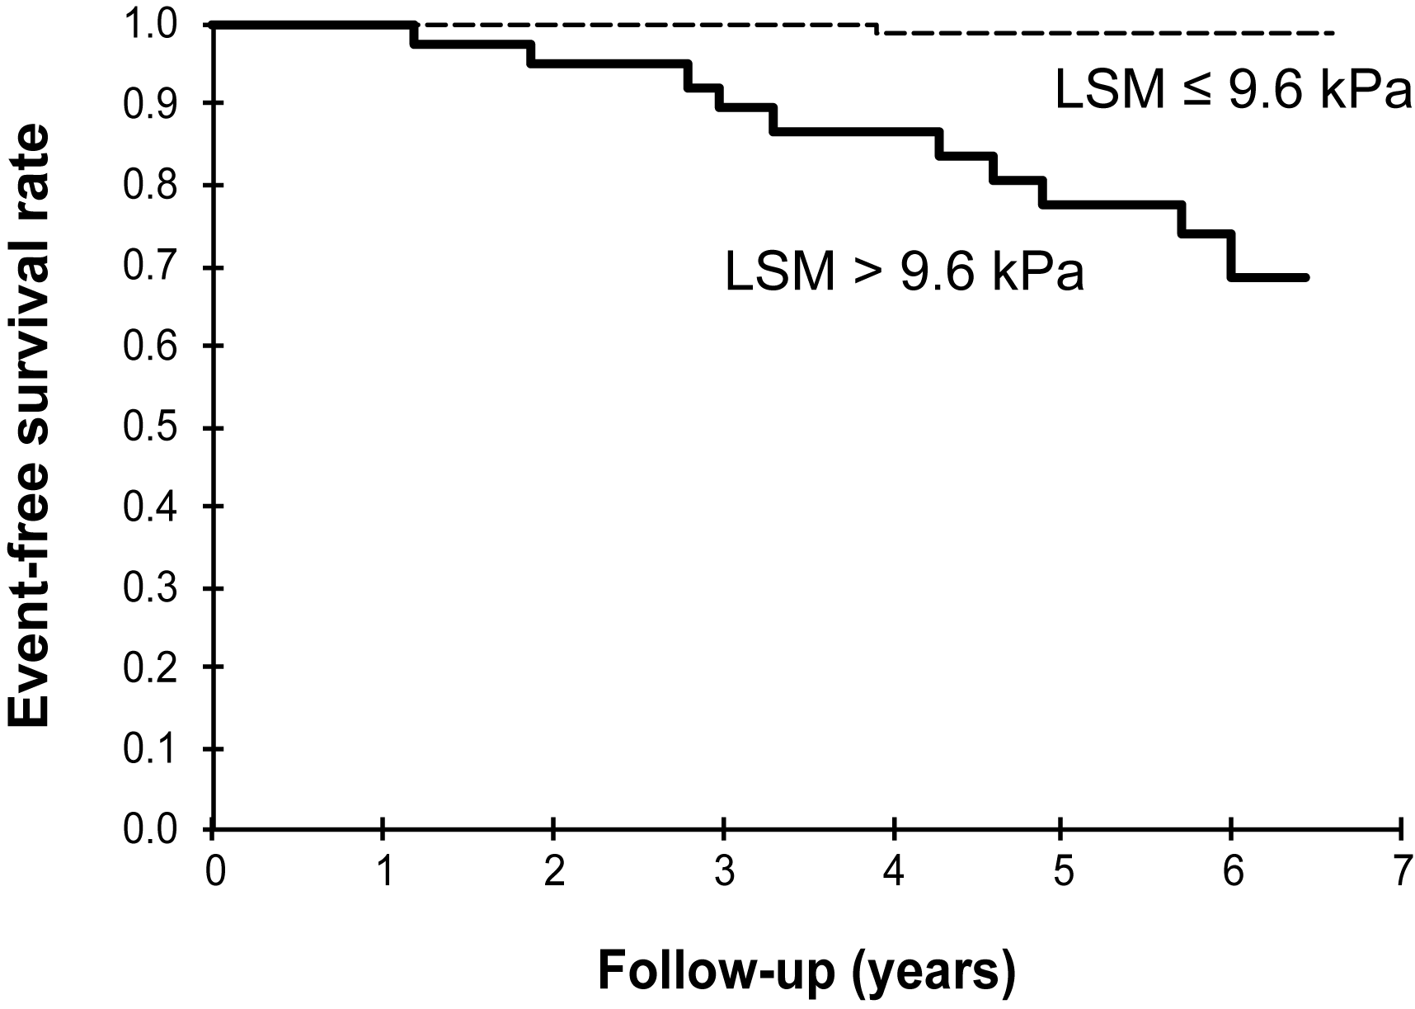
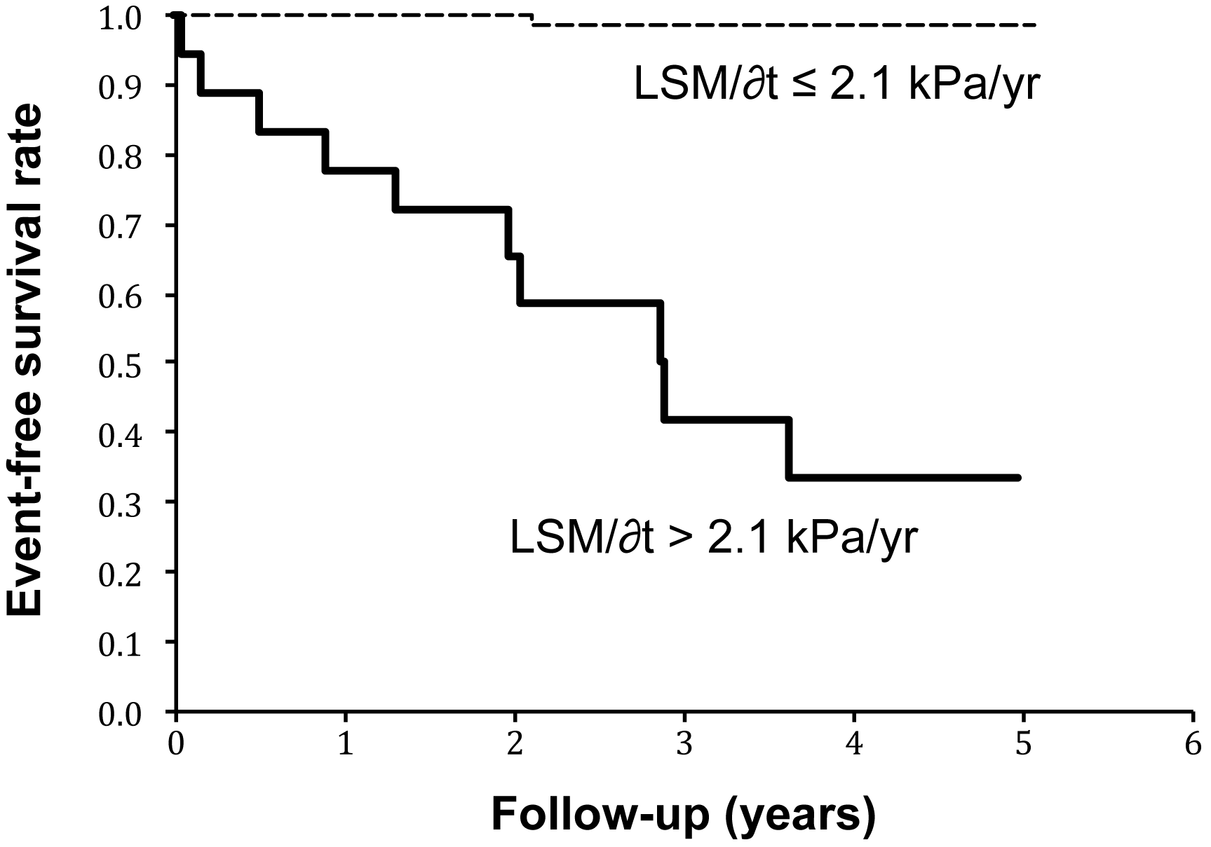
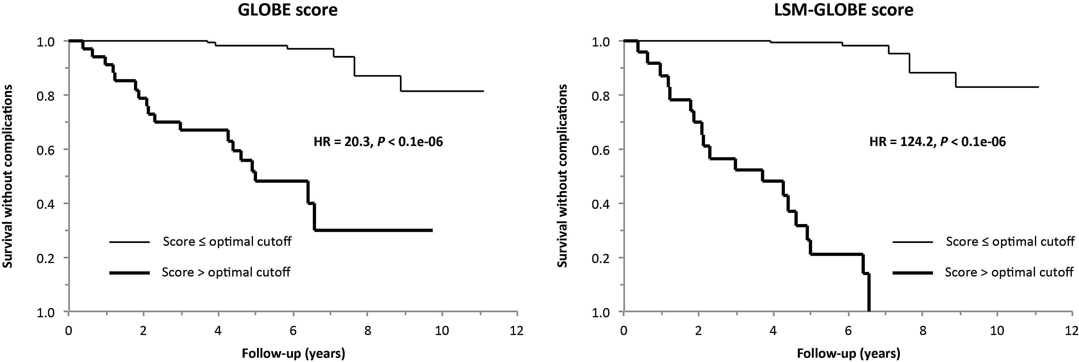
Transient elastography
Evaluating severity
Predicting outcome
Limitations
LSM predicts clinical outcomes
(Corpechot et al. Hepatology 2012)
LSM improves the new risk scores’ prediction
(Corpechot et al. EASL 2016, Barcelona)

Slide 22
Transient elastography
Evaluating severity
Predicting outcome
Limitations
5% failure rate
Up to 20% of unreliable results (IQR/median > 0.3)
Influenced by cholestasis and inflammation

Slide 23
Histology
Histological (fibrosis) stage
Interface hepatitis
Ductopenia
New staging systems

Slide 24
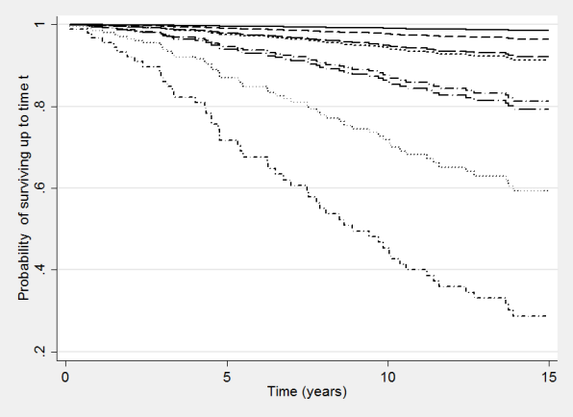
Histology
Histological (fibrosis) stage
Interface hepatitis
Ductopenia
New staging systems
Histological stage is a major independent prognostic factor
(Corpechot et al. Hepatology 2008)
Histological stage adds to the predictive ability of biochemical response
(Carbone et al. EASL meeting 2015, abstract P1198)
Elastography or ELF test are convenient alternative options
 | HR (95% CI) | P-value
Histological stage 3-4 | 1.5 (1.0 – 2.2) | 0.04
Bilirubin > 1 mg/dl | 1.7 (1.1 – 2.6) | 0.01
Non response (Paris I) | 2.3 (1.5 – 3.7) | < 0.001

Slide 25
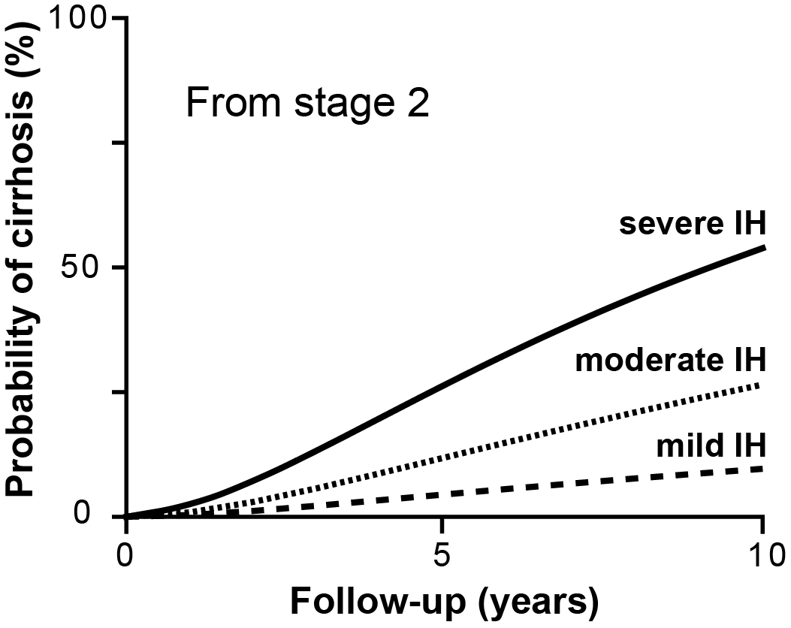
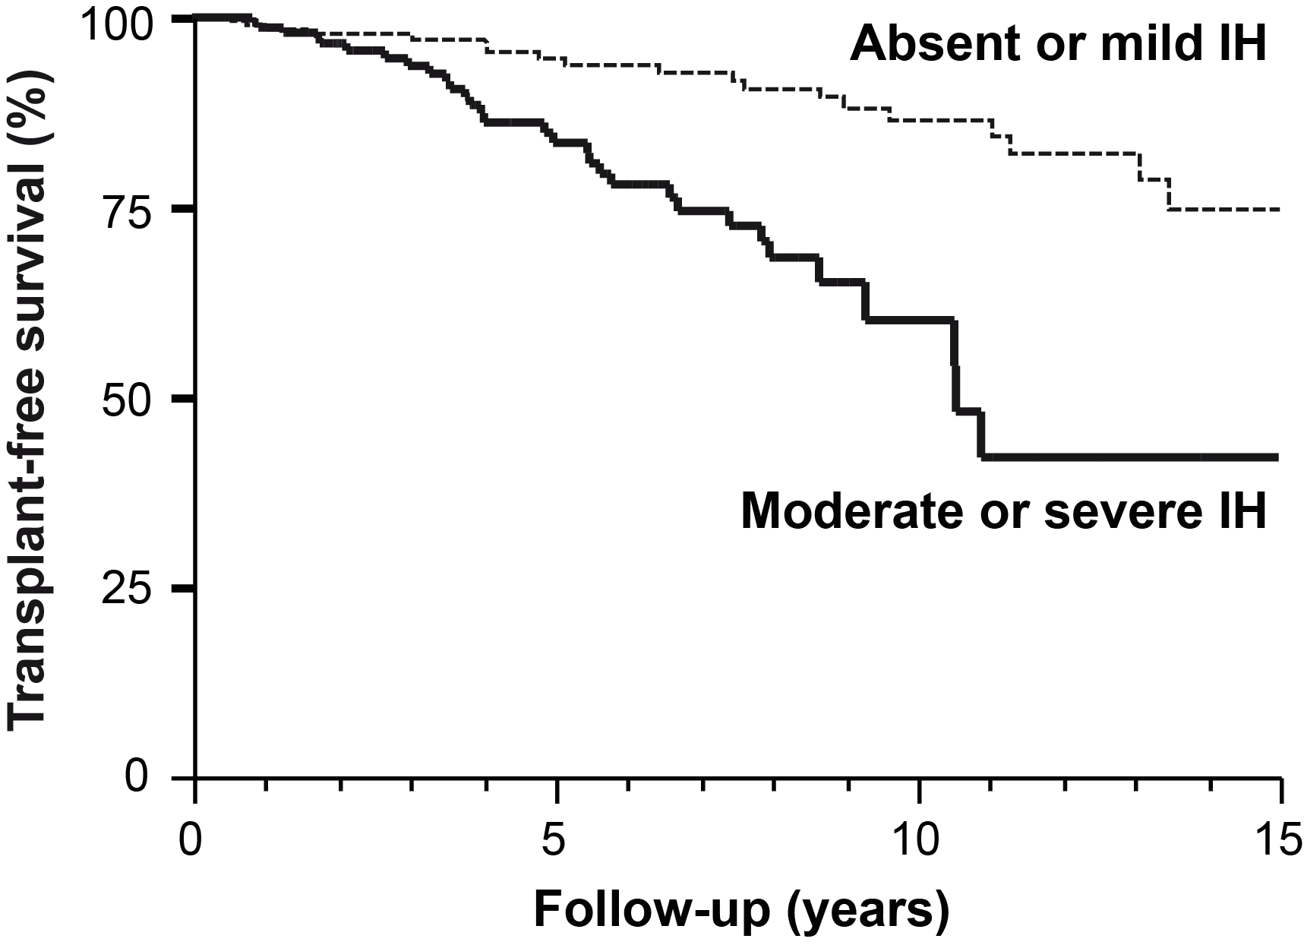
Histology
Histological (fibrosis) stage
Interface hepatitis
Ductopenia
New staging systems
Interface hepatitis is associated with a more progressive disease
(Corpechot et al. Gy 2002 & Hepatology 2008)
Recent large-scale validation from a UK cohort
(Carbone et al. EASL meeting 2015, abstract P1198)
 | HR (95% CI) | P-value
Histological stage 3-4 | 1.5 (1.0 – 2.2) | 0.04
Interface hepatitis | 1.9 (1.2 – 2.9) | 0.002
Non response (Paris I) | 2.3 (1.5 – 3.7) | < 0.001

Slide 26
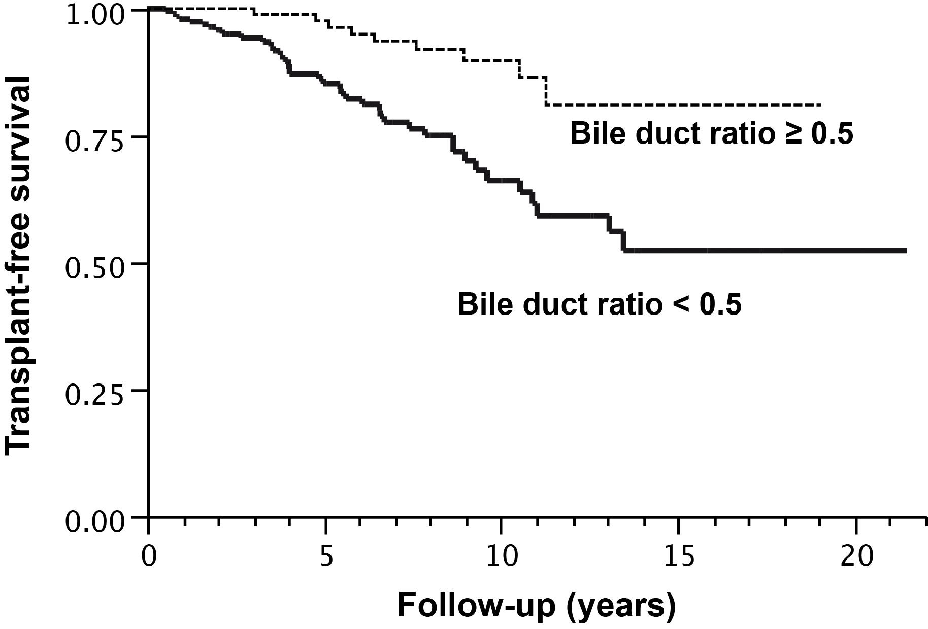
Histology
Histological (fibrosis) stage
Interface hepatitis
Ductopenia
New staging systems
Ductopenia is predictive of poor response to UDCA and of histological progression
(Kumagi et al. Am J Gastroenterol 2010)
It may also be predictive of death or liver transplantation
(Personal data, Saint-Antoine hospital)

Slide 27
Histology
Histological (fibrosis) stage
Interface hepatitis
Ductopenia
New staging systems
The Japanese staging system
(Nakanuma et al. Pathol Int 2010; Kakuda et al. Human Pathol 2013)
The FBI French score
(Wendum et al. Liver Int 2015)
Staging (combined score) | Grading (separate features)
Fibrosis (0 – 3) | Cholangitis activity
Bile duct loss (0 – 3) | Hepatitis activity
Cholestasis (0 – 3)
Fibrosis | 5 stages (0 – 4)
Bile duct ratio | PT with duct/total PT
Interface hepatitis | 4 grades (0 – 3)

Slide 28
In summary
Confidence level | Predictors
High (robust, extensively validated) | Baseline bilirubin and albumin levels Histological stage (or its noninvasive evaluation) Response to UDCA based on ALP and bilirubin New PBC risk scores
Moderate (promising, awaiting large scale validation) | Liver stiffness and its changes AST/platelet ratio ELF test
Insufficient (still limited data or poor expected applicability) | Age category and symptoms PBC-specific ANAs Interface hepatitis and bile duct ratio New histological scoring systems

Slide 29
Conclusion
Many prognostic tools are now available and should improve the design of trials
My proposals for new RCTs would be :
  For patient selection :
    Biochemical response to UDCA based on ALP and bilirubin
    Alternative options: new PBC risk scores
  For risk stratification :
    Histological stage or its noninvasive evaluation (TE ++)
    Alternative options: bilirubin/albumin, new PBC risk scores
Key remaining issue : what optimal endpoint?

